Slide 1
Steve Kerby
Dir. Instructional Technology
and Online Learning
McDaniel College
skerby@mcdaniel.edu
SL Avatar: Online Bookmite
Twitter: stevekerby

Slide 2
Technology as a Place
Designing Environments
Student-Centered Learning
for
Presentation: Sloan-C Conference.
October 29, 2009. Orlando, Florida.

Slide 3
QUESTION: Are Content Management Systems Becoming a Thing of the Past?

Slide 4
AGENDA
Three Assumptions
So What?
Two Programs
Final Question

Slide 5
Three Assumptions

Slide 6
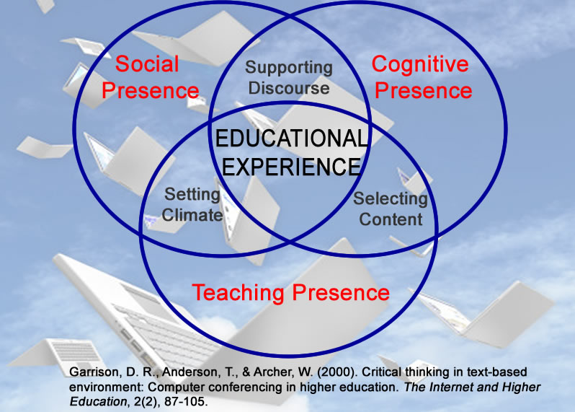
ASSUMPTION 1: Effective Learning Communities

Slide 7
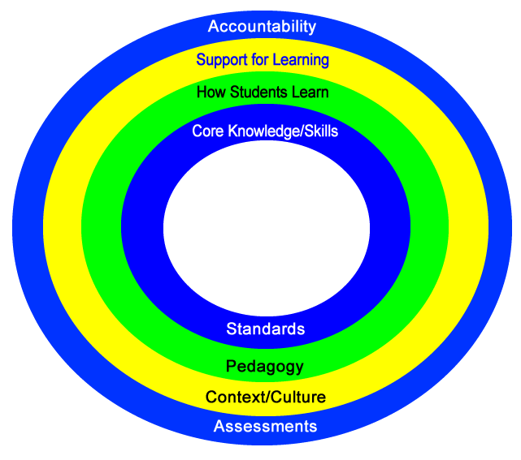
ASSUMPTION 2: Student-Centered Learning is a Value

Slide 8
ASSUMPTION 3: The Universe is About to Change
Virtual Worlds
Google Wave

Slide 9
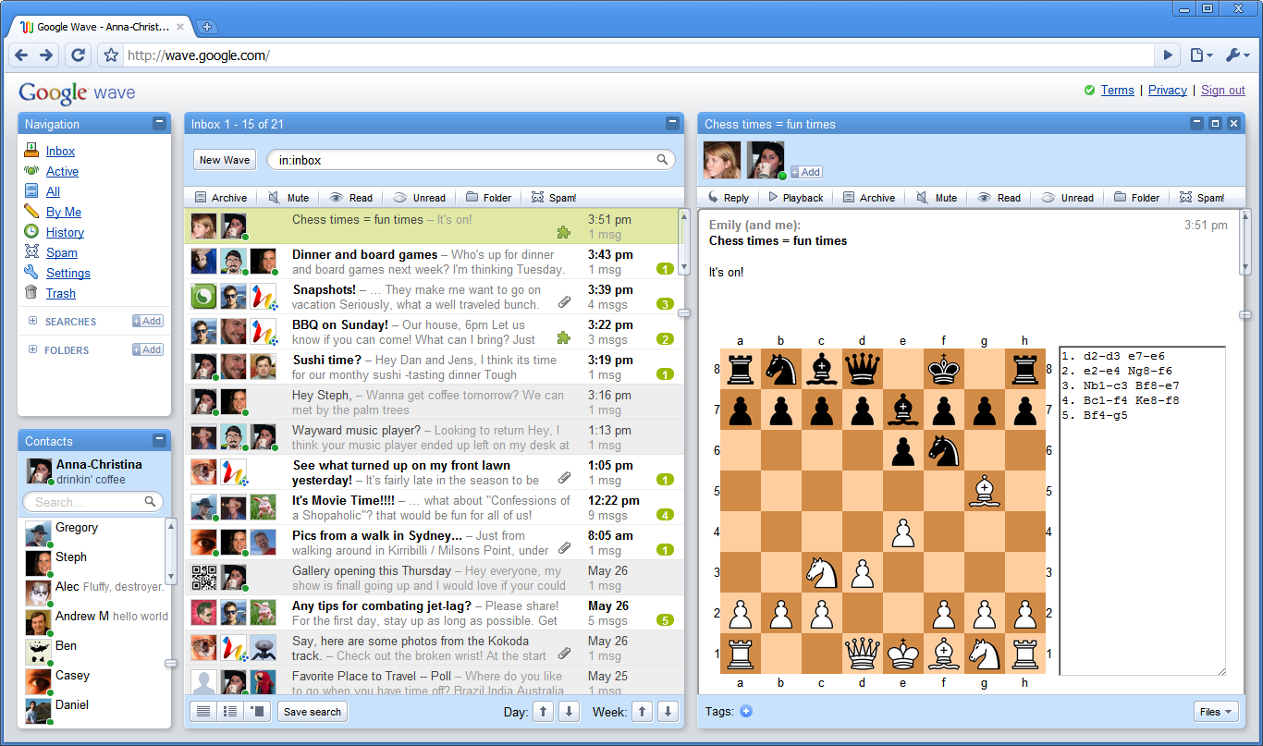
SLM 505 Information Retrieval

Slide 10
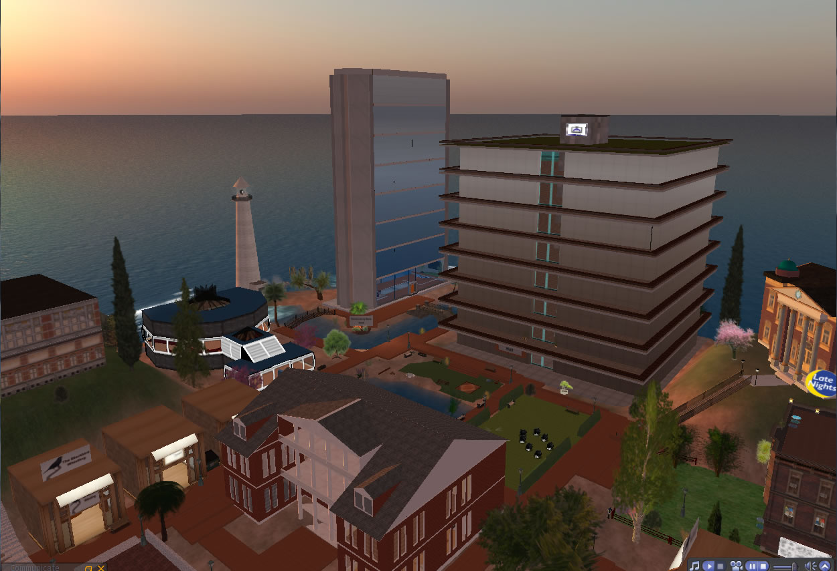

Slide 11
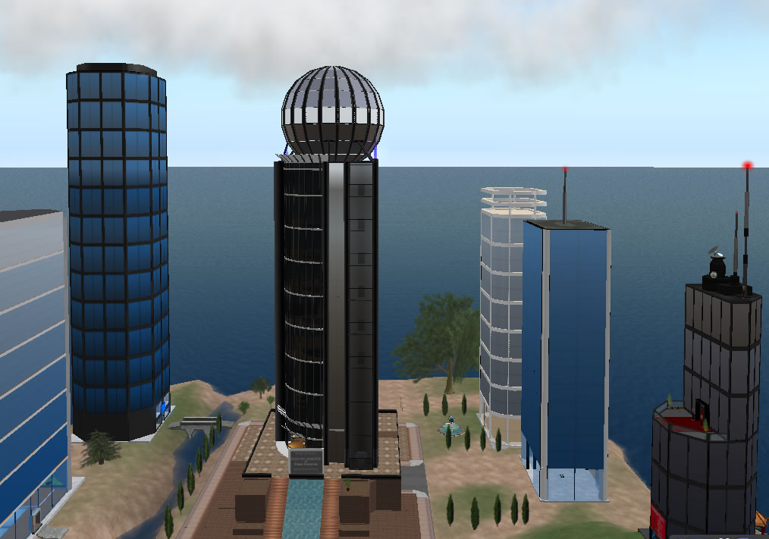

Slide 12
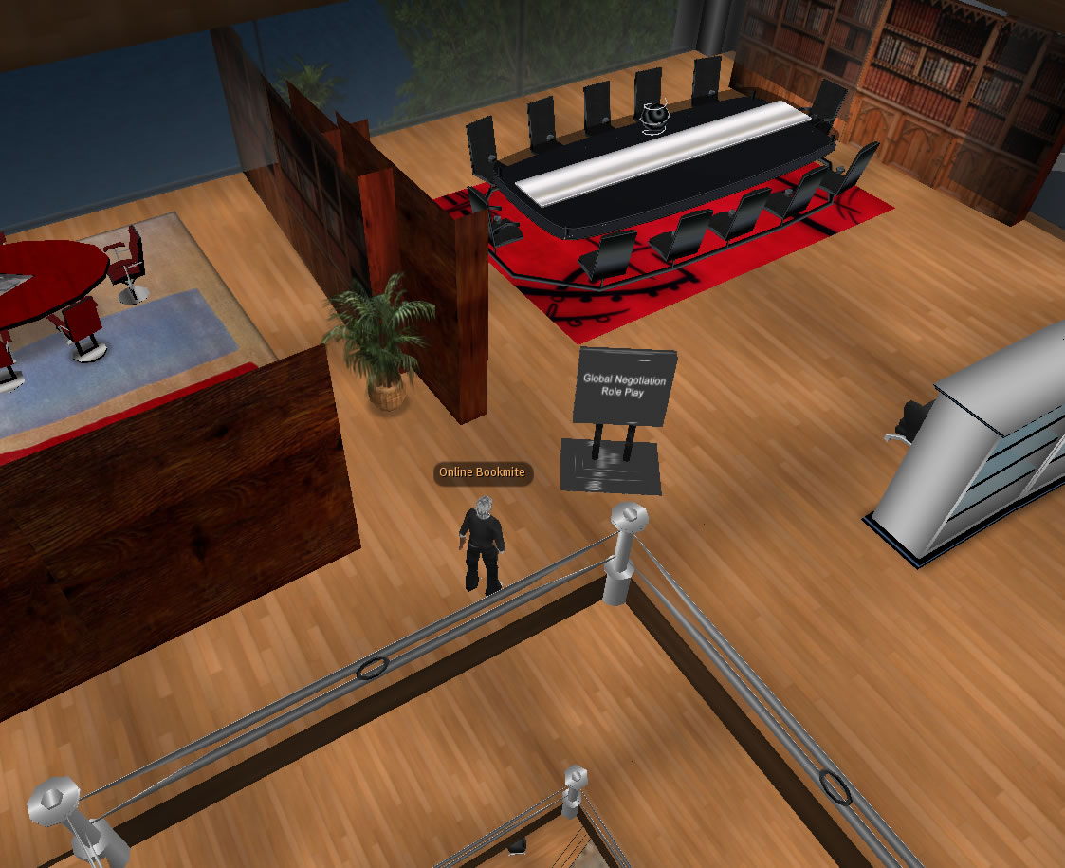

Slide 13
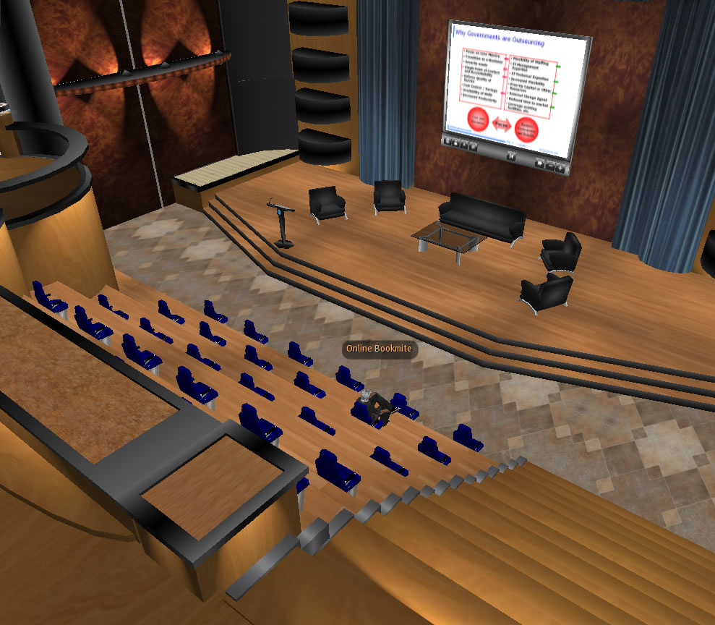

Slide 14
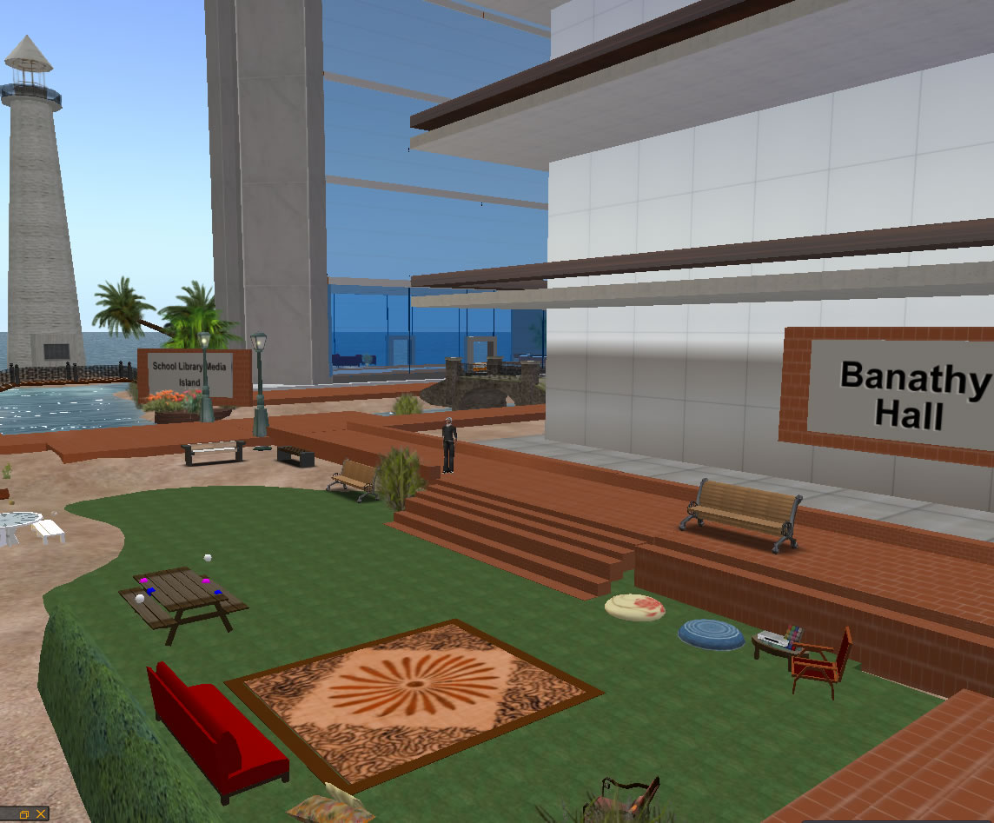

Slide 16
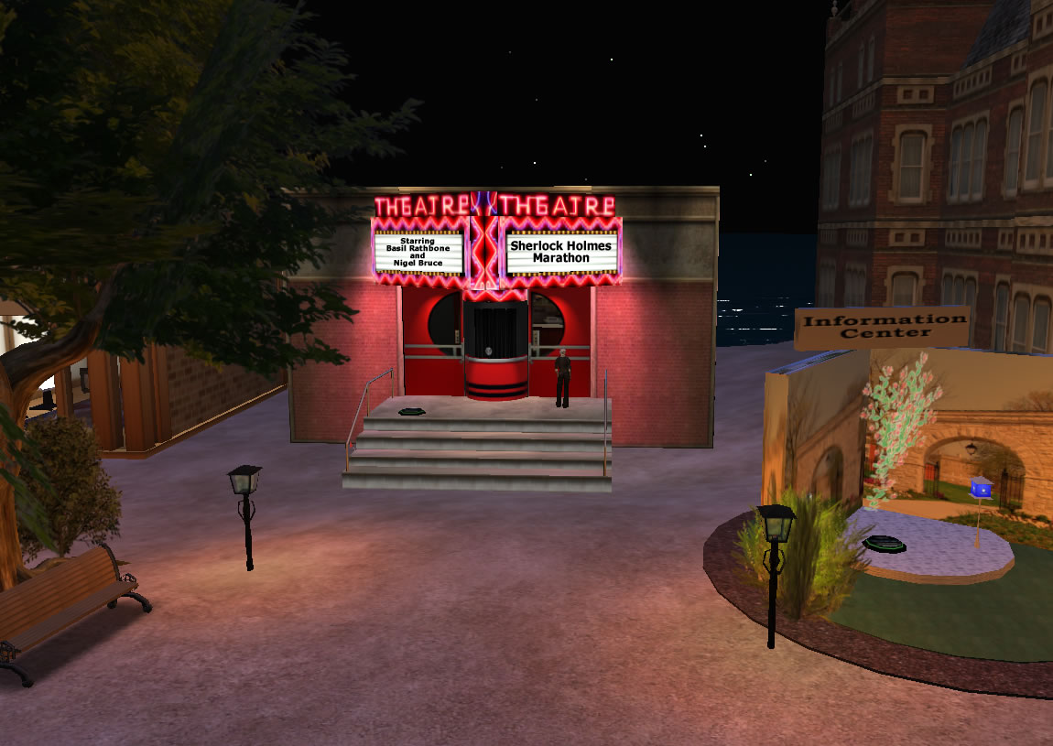

Slide 17
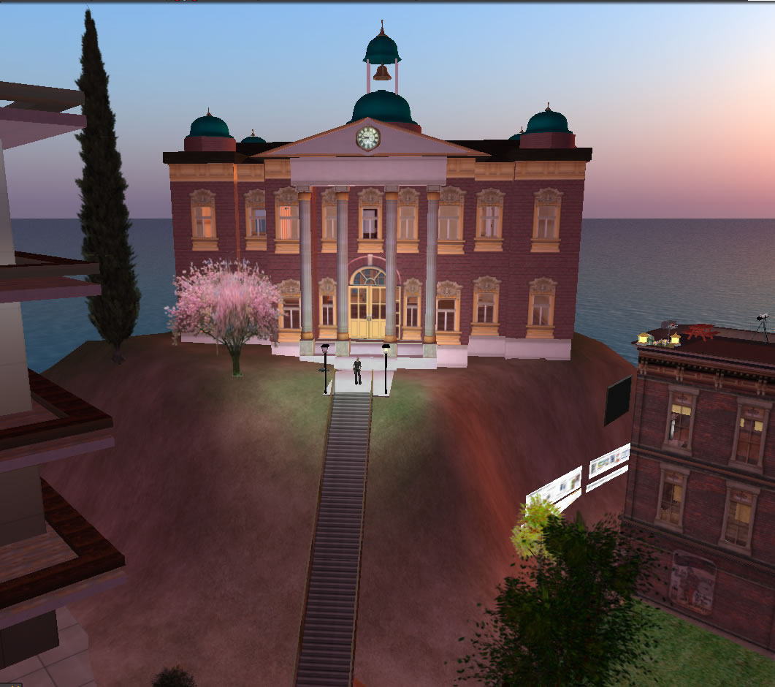

Slide 18
SO WHAT?

Slide 19
THE LONG ARC
2020
2010
Metaverse
GoogleWave
2000
NING
Second Life
Facebook
Moodle
D2L
Angel
Sakai
1990
Blackboard
WebCT
Real/eCollege
Lotus Notes
Convene
Technologies of
Delivery
Technologies of
Place
Text-Based
Communities
Immersive, Media-Constructed Communities
Virtual Online Learning Environments

Slide 20
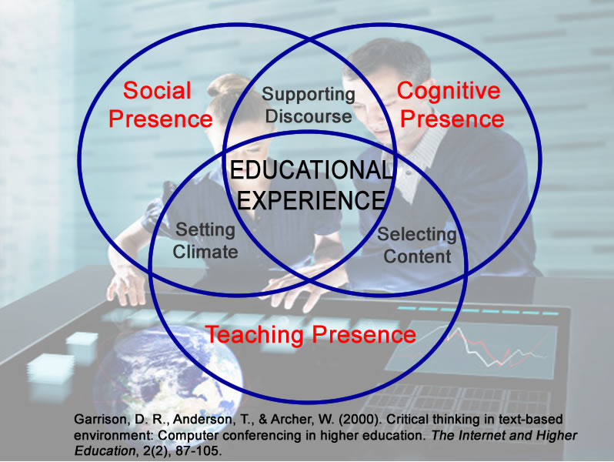

Slide 21
THE LONG ARC
2020
2010
Metaverse
GoogleWave
2000
NING
Second Life
Facebook
Moodle
D2L
Angel
Sakai
1990
Blackboard
WebCT
Real/eCollege
Lotus Notes
Convene
Technologies of
Delivery
Technologies of
Place
Text-Based
Communities
Immersive, Media-Constructed Communities
Virtual Online Learning Environments

Slide 22
Less and less about…
More and more
about…
Reusable Learning Objects
Managing Media
Developing Content
Constructing Communities
Content Management
Systems
Virtual Learning
Environments
Delivering Instruction
Designing Places

Slide 23
THE LONG ARC
2020
2010
Metaverse
GoogleWave
2000
NING
Second Life
Facebook
Moodle
D2L
Angel
Sakai
1990
Blackboard
WebCT
Real/eCollege
Lotus Notes
Convene
Technologies of
Delivery
Technologies of
Place
Text-Based
Communities
Immersive, Media-Constructed Communities
Virtual Online Learning Environments

Slide 24
Two Programs in Transition

Slide 25
Wimba
NING
iTunes
Blackboard
Second Life

Slide 26
Blackboard
Wimba
NING
Second Life

Slide 27
Design Environments
for
Student-Centered Learning
place

Slide 28
QUESTION

Slide 29
QUESTION
With the convergence of social media and the evolution of virtual environments, are traditional Content Management Systems becoming a thing of the past?

Slide 30
Resources
Second Life in Education:
http://sleducation.wikispaces.com/
Metaverse Roadmap:
http://metaverseroadmap.org/index.html
Gartner Hype Cycles:
http://www.gartner.com/it/products/newsroom/index.jsp
Garrison, Anderson, & Archer (2004). Critical Thinking, Cognitive Presence and Computer Conferencing in Distance Education.
http://communitiesofinquiry.com/files/CogPres_Final.pdf

Slide 31
Steve Kerby
Dir. Instructional Technology
and Online Learning
McDaniel College
skerby@mcdaniel.edu
SL Avatar: Online Bookmite
Twitter: stevekerby
Photos: licensed from Getty Images

